Slide 1
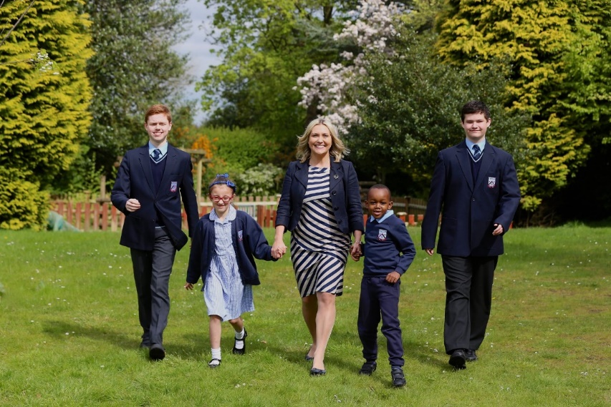
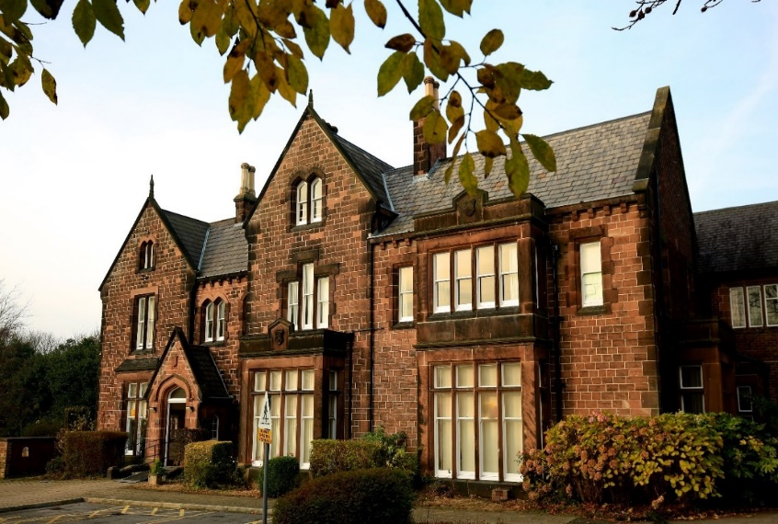
Our School 2022-24

Slide 2
70 Years of Service
Est: 1952

Slide 3
Our Vision and Mission Statement
To be the international Centre of Excellence in Autism education, research and professional development
Our Motto
We want Abbot’s Lea to be the best specialist school in the world!

Slide 4
Our Philosophy of Education: The ASD Model ©
In our work with the students, we will focus equally on:
1. Academic progress
2. Specialist therapeutic support
3. Development of life skills

Slide 5
What The ASD Model © looks like?
Academic progress
Specialist support

Slide 6
Our Code of Conduct: The Golden Rules ©:
1. Be here. Every day…
2. Work hard and be nice
3. Never give up on yourself and others
4. Stay positive and be happy!

Slide 7
Our School Development Strategy
1. Effectiveness of Leadership and Management
To be the international Centre of Excellence in Autism education, research and professional development
2. Our Students
To provide outstanding education to the students
3. Our Families
To work in united partnership with the families
4. Our Team
To recruit, develop and retain the best professionals
5. Our Autism Research and Development
To lead innovation and positive change in the field of Autism
6. Our Resources
To use the resources available for the greatest benefit of the school

Slide 8
Policies and Procedures
Schools are classed as “Regulated Activity” and so, are heavily….regulated! Our policies reflect this and we are obliged to adhere to them at all times:
http://www.abbotsleaschool.co.uk/documents/school-policies/
Drawing attention to:
- Positive Behaviour Support
- Child Protection
- Staff Code of Conduct
- Staff Dress Code

Slide 9
National Priorities
Education White Paper (full doc: 68 pages):
https://assets.publishing.service.gov.uk/government/uploads/system/uploads/attachment_data/file/1063602/Opportunity_for_all_strong_schools_with_great_teachers_for_your_child__print_version_.pdf
Summary of the Education White Paper (25 pages):
https://researchbriefings.files.parliament.uk/documents/CBP-9511/CBP-9511.pdf
SEND Green Paper (full doc: 106 pages)
https://assets.publishing.service.gov.uk/government/uploads/system/uploads/attachment_data/file/1063898/SEND_review_right_support_right_place_right_time-print_ready.pdf
Summary of the SEND Green Paper (7 pages):
https://assets.publishing.service.gov.uk/government/uploads/system/uploads/attachment_data/file/1064655/SEND_Review_Right_support_right_place_right_time_summary.pdf

Slide 10
Local SEND Priorities
SEND Sufficiency Consultation:
https://liverpool.gov.uk/council/consultation-and-engagement/consultation/consultation-on-proposals-to-review-the-organisation-of-special-school-provision-in-liverpool/

Slide 11
Our school priority

Slide 12
School Development Plan 2022-24
Our Students
Our Team
Our Resources

Slide 13
Leadership and Management
1. We will review, revive and re-launch our school’s vision
2. We will innovate, driving the standards of all that we do, and regularly review and improve our policies and procedures
3. We will work to improve our external evaluation by Ofsted
4. We will actively engage in appraising our options related to national and local agenda
KPI | Abbot’s Lea School is financially stable, clear about its operation, going from strength to strength, as supported by the feedback from a range of internal (students, families and staff) and external stakeholders, internal audits, self-evaluation and a range of inspections.

Slide 14
Our Students
1. We will ensure that students attend well and are engaged in school-based learning
2. We will maximise opportunities for our students’ academic excellence and exposure to cultural capital
3. We will ensure that our students’ complex needs are understood well and that they are supported by their class teams and multi-disciplinary experts to reach their full potential
KPI | We will demonstrate – year on year - improved attendance at school and engagement in class-based learning across all groups
KPI | We will demonstrate, through annual reports and case studies, enhanced progress and achievement across all groups
KPI | We will demonstrate reduction in high level crisis behaviours including restrictive physical interventions (RPI)

Slide 15
Our Team
1. We will ensure that every staff member, regardless of their role, has a sound knowledge of how to best support our school and applies that knowledge consistently to drive positive change
2. We will support our team with maintaining a healthy work-life balance and mental health, including personal and professional resilience.
3. We will review our organisational structure, including Leadership Team
KPI | We will demonstrate clear accountability for standards of our work across the wide range of school’s functions
KPI | We will see improved staff’ morale and metrics related to attendance (note: Covid) and retention
KPI | We will operate within our means, whilst optimising our team’s strength now and the future, recruiting and retaining effective practitioners.

Slide 16
Our Resources
1. We will manage the budget allocated to the school in a way that is responsible and helps support this School Development Plan
2. We will continue to enhance all internal and external spaces on site
3. We will continue to actively engage in investigating more suitable spaces for ALS’ operation, so that all students – present and future – have state-of-the-art school to enjoy
KPI | Internal budget monitoring and external scrutiny shows balanced budget compliant with SBVS, with the feedback from Committees and Seeing is Believing sessions demonstrating money being spent in a way that helps the school realise its vision.
KPI | ALS campus will continue evolving in line with the needs of its operation, creating high quality spaces for learning, work and community participation
KPI | We will explore all LCC and non-LCC development options and appraise each of them fully, objectively and transparently, before consulting with our community on the best way to provide excellent learning environment to our students.

Slide 17
Strategic Leadership Team (SLT)
Headteacher
Executive PA and Clerk to GB
Deputy Headteacher
Head of Care and Safeguarding
Head of Autism Research and Development
Head of HR
Head of Finance and Operations
Liverpool City Council
Governing Body

Slide 18
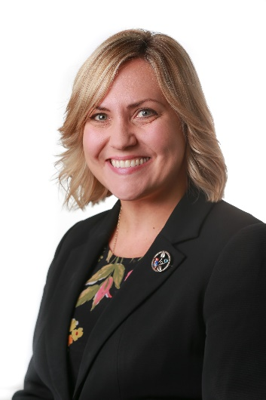
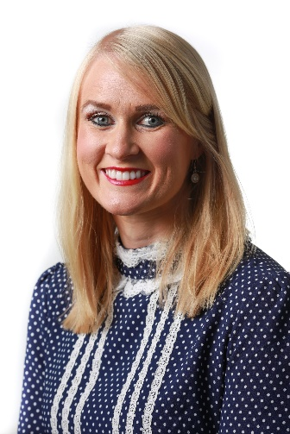
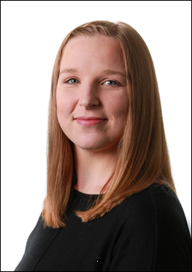
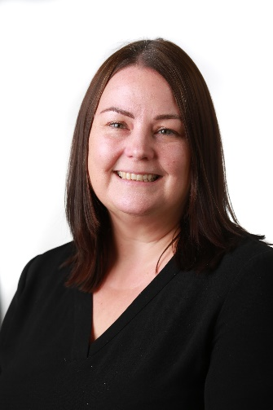
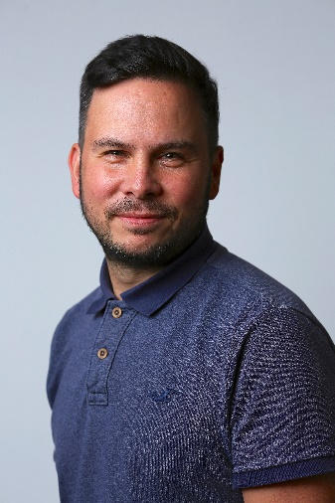
SLT

Slide 19
Operational Structure – Teaching and Learning
Key Stage Leaders
HLTA
TAs
Teachers
HLTAs
TAs
Deputy Headteacher
Employability Manager
Intern Coach

Slide 20
Operational Structure – Care and Safeguarding
Head of Care and Safeguarding
Positive Behaviour Support Leader
Child Psychotherapist
Speech and Language Therapist
Occupational Therapist
Safeguarding Officer
6x Positive Behaviour Support Assistants
Safeguarding Assistant

Slide 21
Operational Structure - Autism Research and Development
Head of Autism Research and Development
Family
Advice
Internal Innovation Projects and Training
External Innovation Projects, Partnerships and Training
Research Publications
Student
Voice

Slide 22
Operational Structure – School Business Support
Head of HR
HR Officer
Head of Finance and Operations
Office Manager
Facilities Manager
IT Manager
Data Manager
Facilities Team
Administrators
Finance and Payroll Officer
Catering Team
Cleaning Team
IT Apprentice

Slide 23
Operational Leadership Team (OLT)
OLT
Maria Hattersley
Key Stage Leader – EYFS/KS1
Matthew Lyons Key Stage Leader – KS4
Richard Hodgson
Key Stage Leader – KS3
Ryan Mason
Key Stage Leader – KS5
Ian Weston Facilities Manager
Nathan Fernyhough Employability
Manager
Jennie Shipley Data Manager
Keri Myers
Office Manager
IT Manager
Claire Welch
Positive Behaviour Support Leader
Laura Gibney Key Stage Leader – KS2

Slide 24
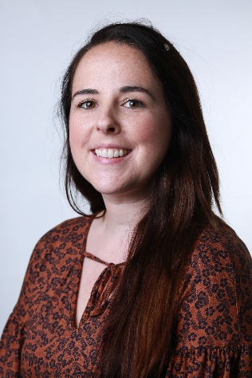
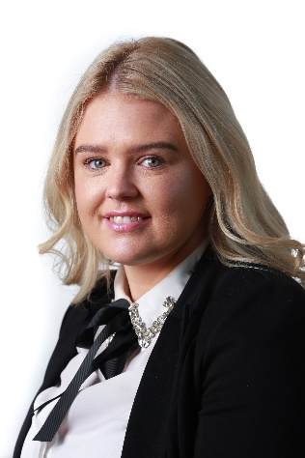
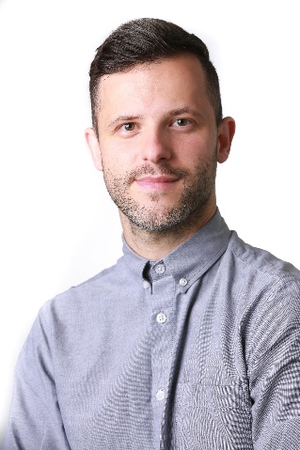
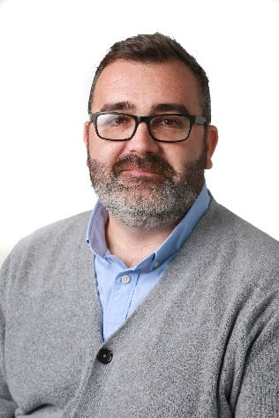
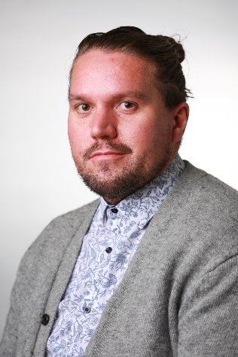
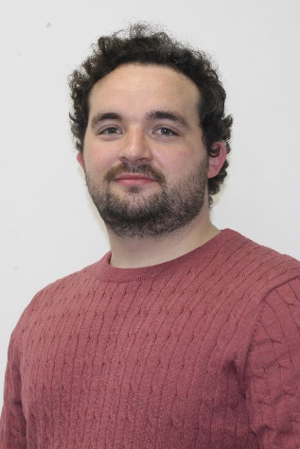
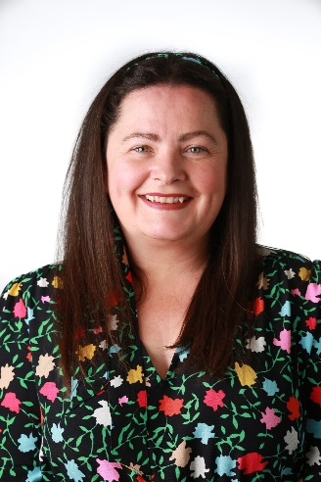
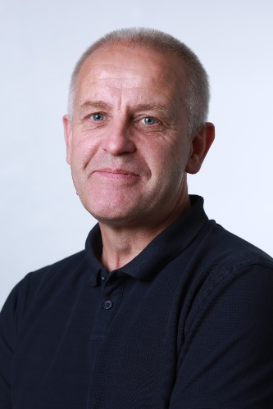
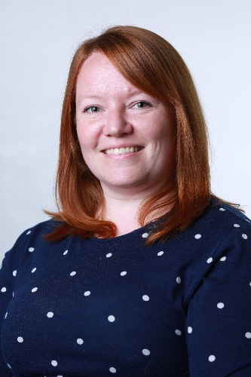
OLT
IT Manager

Slide 25
Overview and Scrutiny
Our Students Committee 2-4pm | Our Team Committee 8:30 – 10:30am | Our Resources Committee 3-5pm
Thursday 13 October 2022 (Week 7) Thursday 8 December 2022 (Week 14) Thursday 2 February 2022 (Week 21) Thursday 23 March 2022 (Week 27) Thursday 18 May 2022 (Week 33) Thursday 6 July 2022 (Week 39) | Thursday 13 October 2022 (Week 7) Thursday 8 December 2022 (Week 14) Thursday 2 February 2022 (Week 21) Thursday 23 March 2022 (Week 27) Thursday 18 May 2022 (Week 33) Thursday 6 July 2022 (Week 39) | Thursday 13 October 2022 (Week 7) Thursday 8 December 2022 (Week 14) Thursday 2 February 2022 (Week 21) Thursday 23 March 2022 (Week 27) Thursday 18 May 2022 (Week 33) Thursday 6 July 2022 (Week 39)
Full GB meetings (4-6pm):
Term 1 – 1 September 2022 at 2pm – Policies (Zoom)
Term 2 – 23 November 2022
Term 4 – 22 February 2023
Term 6 – 8 June 2023
Term 6 - Annual Business Meeting – 12 July 2023

Slide 26
Contact details
Ania Hildrey, Headteacher of Abbot’s Lea School
headteacher@abbotsleaschool.co.uk
Twitter:
@AbbotsLeaSchool
@HeadteacherALS

